Slide 1
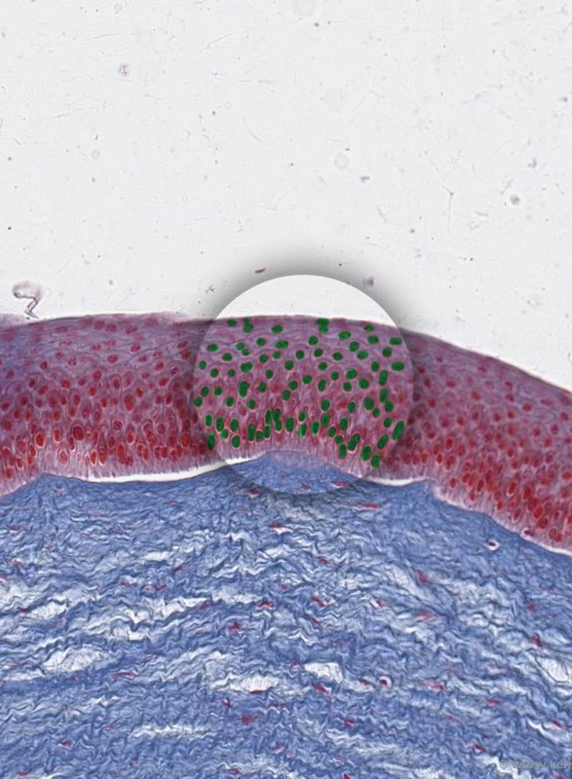
Tissues
AEHBY ATAR Human Biology

Slide 2
Review
List the four structural levels of body organisation.
Which structure includes all parts within the cell, except the nucleus?
Define tissue, in terms of types of cells and cell functions.
Which organelle is responsible for modification of proteins?
Explain the function of carrier proteins.
Define hypertonic, isotonic and hypotonic.

Slide 3
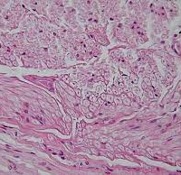
Learning Intentions
the various tissues of the human body perform specific functions and can be categorised into four basic tissue types: epithelial, connective, muscular and nervous

Slide 4
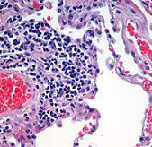
Success Criteria
Describe four tissue types
Give examples for each
Classify examples from images or descriptions

Slide 5
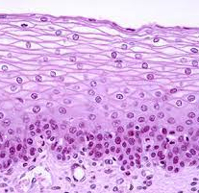
Epithelium (epithelial tissue)
covering or lining
cells are stacked or layered closely
single or multiple layers
form a smooth surface
named according to shape of cells, eg smooth epithelium, columnar epithelium, cuboidal epithelium

Slide 6
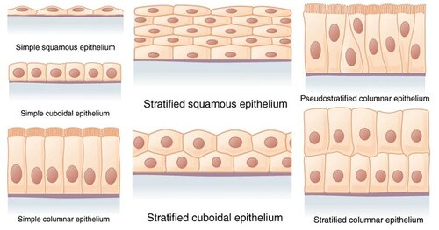

Slide 7
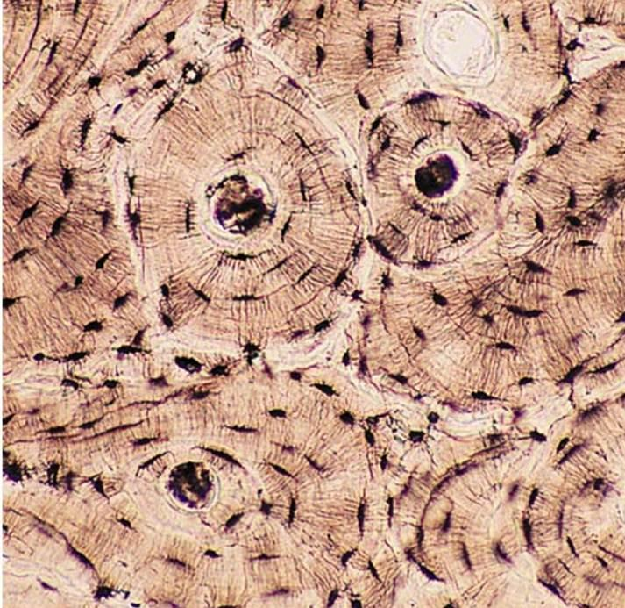
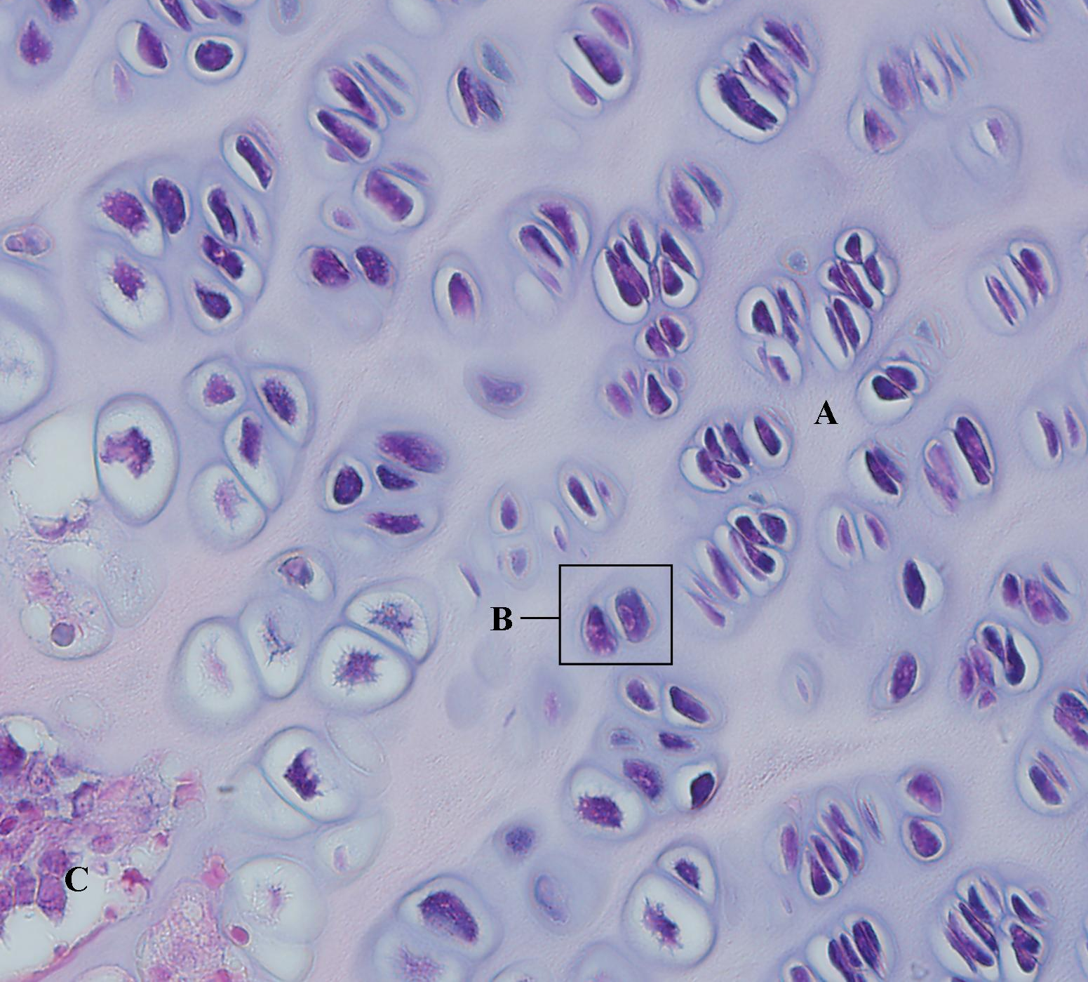

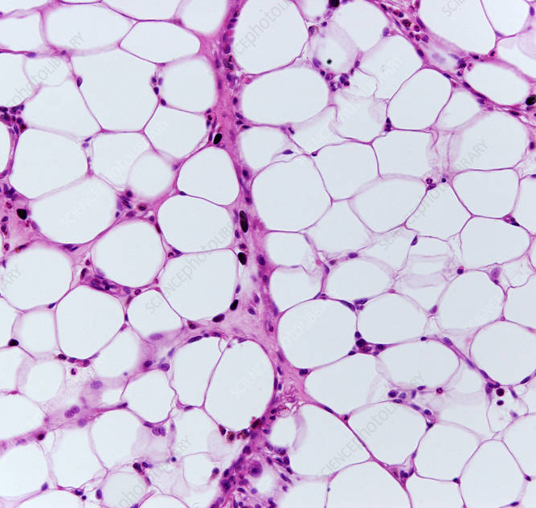
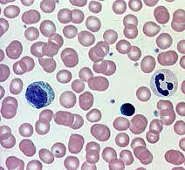
Connective tissue
provides support
cells separated by large amounts of non-cellular material (‘matrix’)
eg bone, cartilage, fibrous, adipose, blood

Slide 8
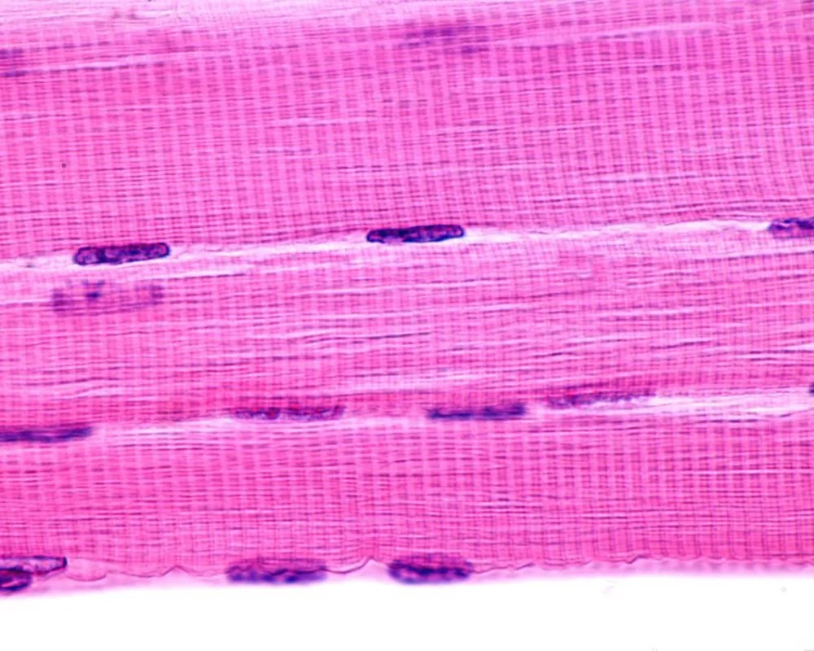
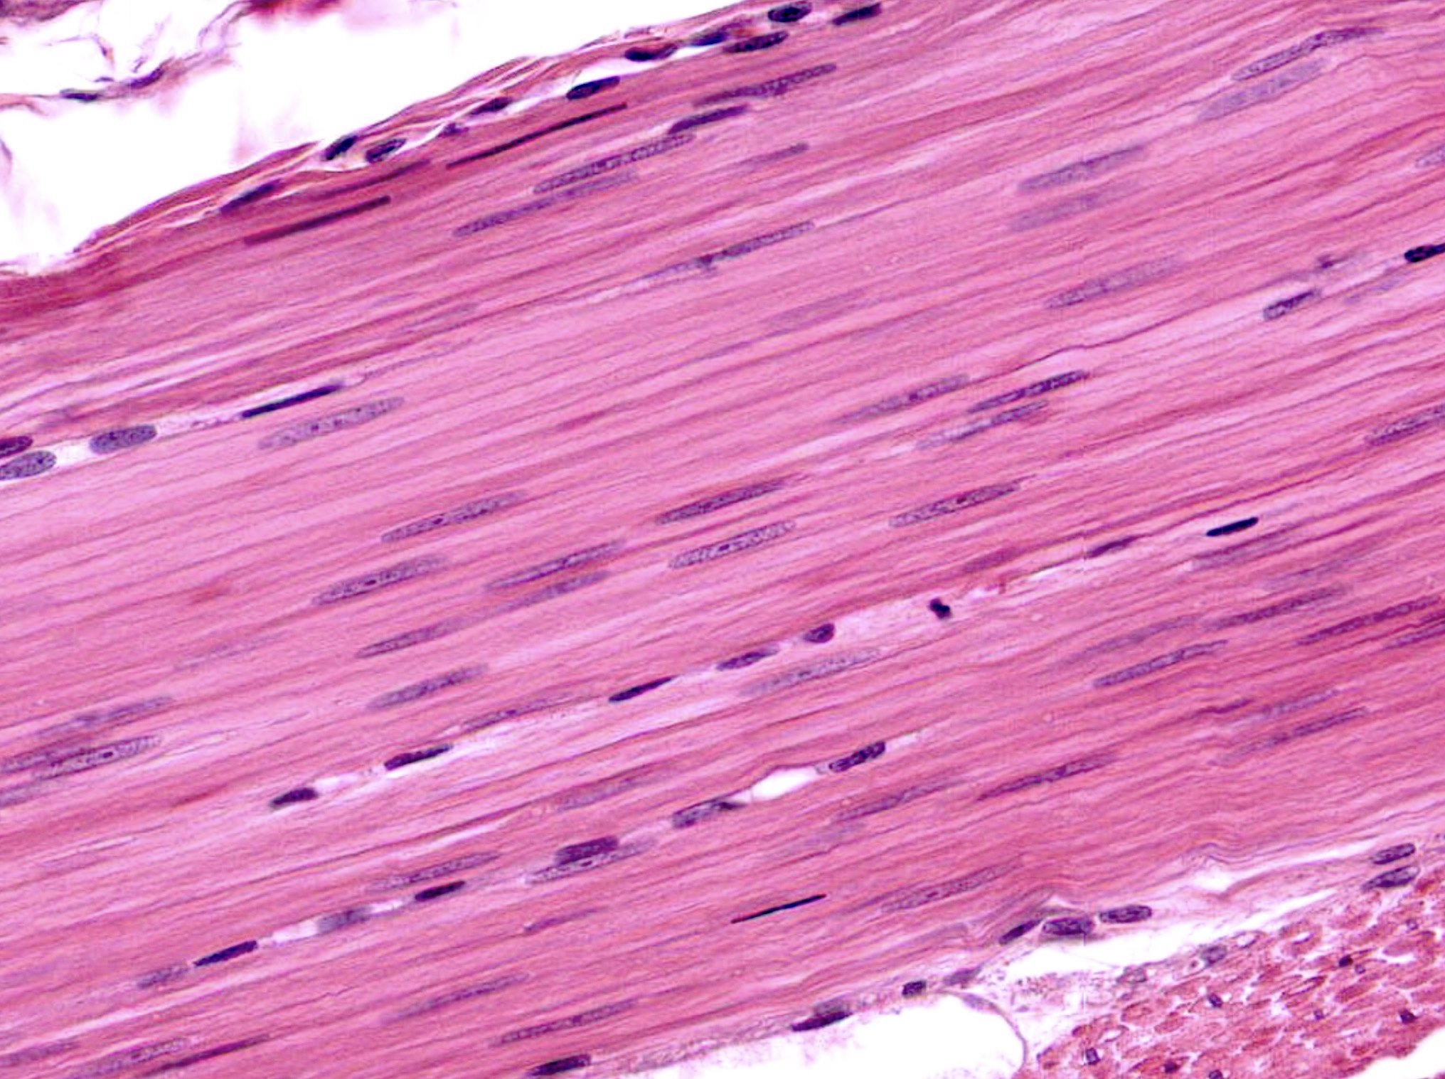
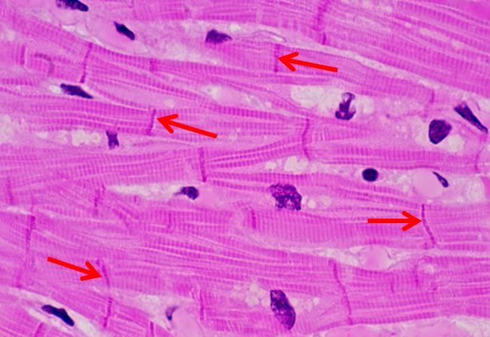
Muscle tissue
fibrous, contractile
skeletal (voluntary/striated), smooth (involuntary/non-striated) or cardiac (heart)

Slide 9
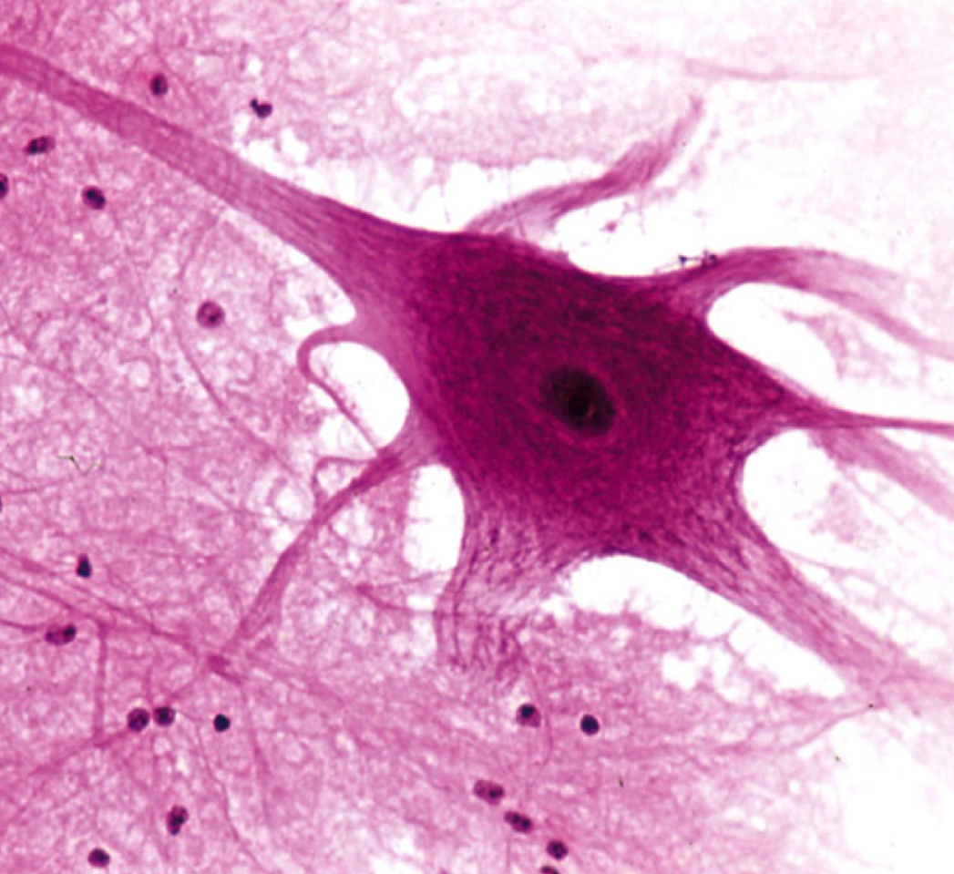
Nervous tissue
specialised nerve cells (‘neurons’) and their support cells
brain, spinal cord and nerves

Slide 10
Questions
List four locations of epithelial tissue.
What are striations?
What type of muscle tissue would be found in arteries?
What type of tissue is blood and why is it classified this way?
What is the matrix of bone?

Slide 11
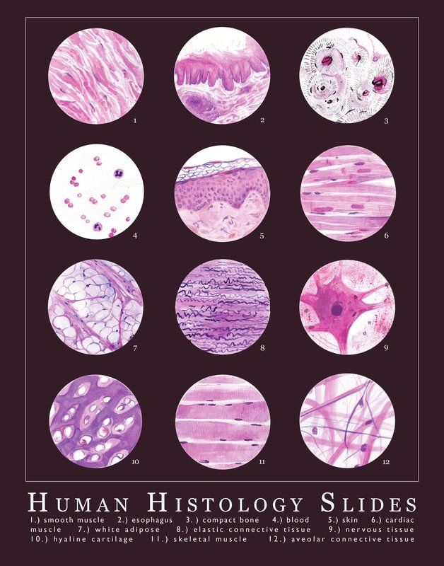

Slide 12
Success Criteria
Describe four tissue types
Give examples for each
Classify examples from images or descriptions

